Slide 1
Express – node.js Web Application Framework
Pravinkumar Dabade

Slide 2
Agenda
What is Express?
Why to use Express?
What is middleware?
Introduction to Express middleware
body-parser, cookies, sessions, authentication and many more ..
Creating first Express application
Routing with express
Express templating engine

Slide 3
What is Express?
Express is a minimal, open source and flexible node.js web app framework designed to make developing websites, web apps and APIs much easier.

Slide 4
Why use Express?
Express helps you respond to requests with route support so that you may write responses to specific URLs.
Supports multiple templating engines to simplify generating HTML.
Default templating engine is jade.

Slide 5
Installing and using Express
npm install express
npm install jade

Slide 6

express() function
The express() function is a top-level function exported by the express module.
The express() function creates an Express application

Slide 7
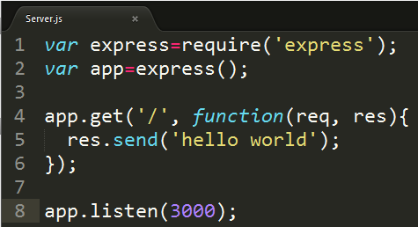
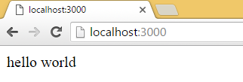
Simple Express application

Slide 8
app object of express()
Routing HTTP requests; see for example, app.METHOD and app.param.
Configuring middleware; see app.route.
Rendering HTML views; see app.render.
Registering a template engine; see app.engine.

Slide 9
What is middleware?
Middleware is a function which has access to the request and response object and the next middleware function in the application’s request-response cycle.
The next middleware function is commonly denoted by a variable named next.

Slide 10
Job of middleware functions
Execute any code.
Make changes to the request and the response objects.
End the request-response cycle.
Call the next middleware function in the stack.
Note - If the current middleware function does not end the request-response cycle, it must call next() to pass control to the next middleware function. Otherwise, the request will be left hanging.

Slide 11
Express application middleware
Express application can use different types of middleware –
Application-level middleware
Router-level middleware
Error-level middleware
Built-in middleware
Third-party middleware

Slide 12
Application-level middleware
Bind application-level middleware to an instance of the app object by using –
app.use()
app.method()
METHOD is the HTTP method of the request that the middleware function handles (such as GET, PUT, or POST) in lowercase.
Example of Simple Application-level Middleware use

Slide 13
Router-level middleware
Router-level middleware works in the same way as application-level middleware, except it is bound to an instance of express.Router().
Load router-level middleware by using the router.use() and router.METHOD() functions.
var router = express.Router();
Example of Simple Router-level Middleware use

Slide 14
Error Handling Middleware
Error-handling middleware always takes four arguments
You must provide four arguments to identify it as an error-handling middleware function
Even if you don’t need to use the next object, you must specify it to maintain the signature
Otherwise, the next object will be interpreted as regular middleware and will fail to handle errors.
Example of Error Handling middleware

Slide 15
Built-in middleware
Express 4.x has only one built-in middleware which is express.static
Responsible for serving static assets such as HTML files, images, and so on.
Starting with version 4.x Express, all of the middleware functions that were previously included with Express’ are now in separate modules.

Slide 16
Few middleware
body-parser
cookie-parser
cookie-session
express-session
morgan
serve-favicon
csurf
errorhandler
passport

Slide 17

Third-party middleware
Use third-party middleware to add functionality to Express apps.
For example –

Slide 18
Let’s Build Express Application

